Slide 1
Secure Access to Research Infrastructure via the InCommon Federation
Jim Basney
jbasney@ncsa.uiuc.edu
Notes:
Presented at the University of Notre Dame Scientific Computing Workshop (http://www.nd.edu/~dthain/scw2011/), Feb 23 2011.

Slide 2
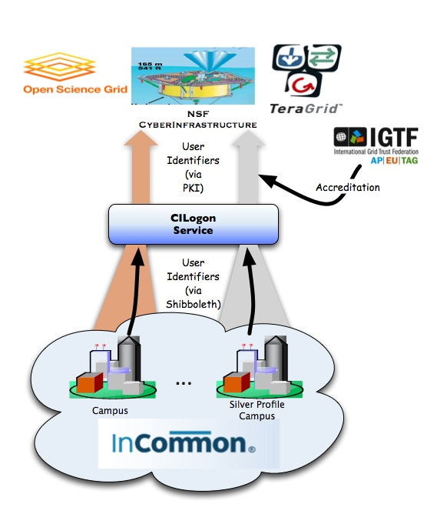
CILogon Project Goal
Enable campus logon to CyberInfrastructure (CI)
Use researchers’ existing security credentials at their home institution
Ease credential management for researchers and CI providers

Slide 3
InCommon Federation
InCommon is the federation for U.S. research and education, providing higher education and their commercial and non-profit partners with a common trust framework for access to online resources.
Notes:
InCommon is the higher education and research federation in the U.S.
InCommon serves as the trust agent for all participants.

Slide 4
About InCommon
Through InCommon, campuses leverage their identity databases to allow for the use of one set of credentials to access multiple resources.
Online service providers no longer need to maintain user accounts.
Identity providers manage the levels of their users' privacy and information exchange.
InCommon uses SAML-based authentication and authorization systems (such as Shibboleth®) to enable scalable, trusted collaborations among its community of participants.
Notes:
Privacy, security and scalability are the heart of the benefits of InCommon and a federated identity management approach.

Slide 5
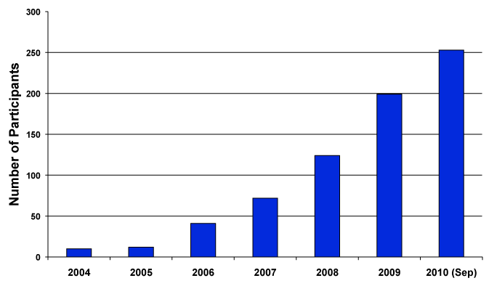
InCommon Participants Year-by-Year
253 InCommon Participants (Sept. 2010)
Almost 5 million end-users (faculty, staff, students)
Notes:
As September 2010, InCommon has 253 participants, including 180 colleges and universities.

Slide 6
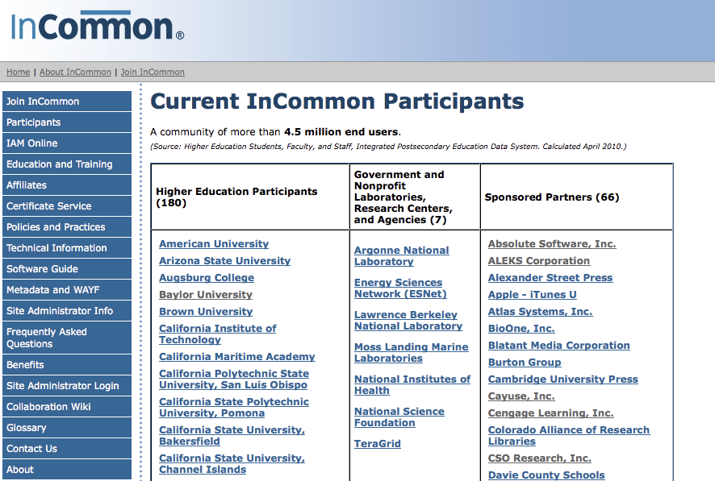
www.incommonfederation.org/participants
Notes:
InCommon participants include colleges and universities, government and non-profit research facilities and agencies, and sponsored partners – non-profit and for-profit entities that offer federated services.

Slide 7
Federated Resources Resources available via InCommon are many and diverse
Business Functions
Benefits
Asset management
Talent management
Visas & INS compliance
Mobile alerts
Travel management
Energy management
Surveys and market analysis
Learning and Research
Journals
Databases and analytical tools
Multi-media access
Homework labs
Quiz tools
Plagiarism detection
Software downloading
Alcohol awareness education
Student travel discounts
Transportation and ride-share services.
Strong support from key higher education partners, such as: Microsoft, Apple, National Student Clearinghouse, NSF, NIH, Gov-affiliated Labs
Notes:
Federated resources offered by InCommon participants affect many campus business and academic functions. There are a number of HR and student services applications, as well as learning management systems, and library databases.

Slide 8
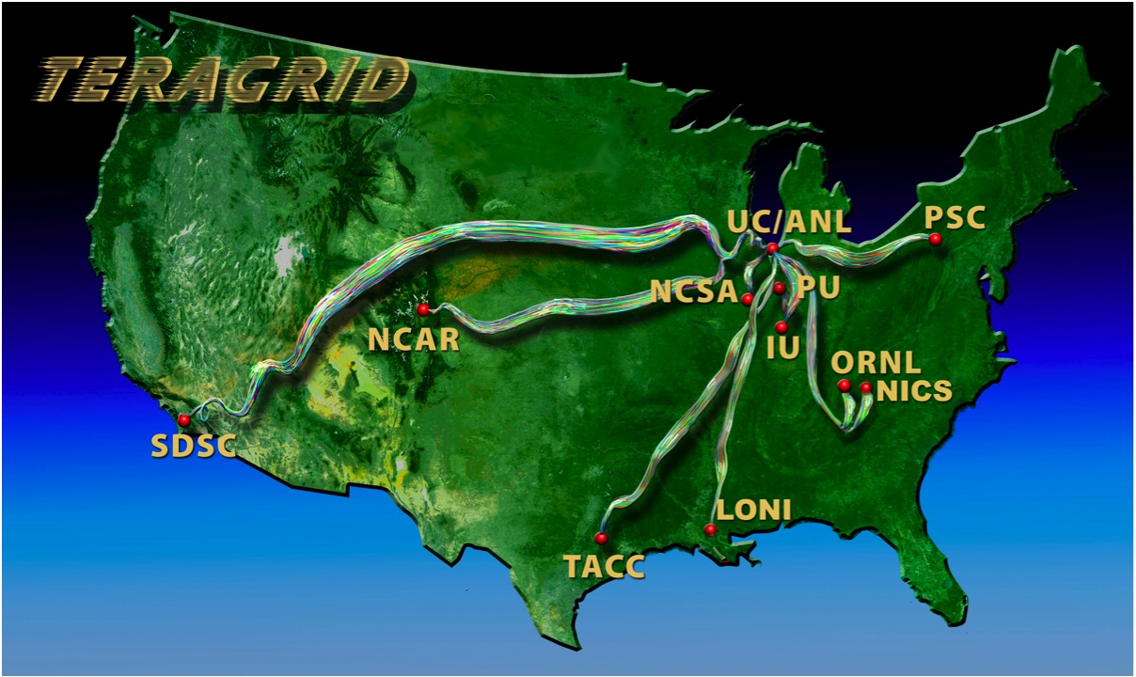
www.teragrid.org
Notes:
The NSF-funded TeraGrid combines leadership class resources at eleven partner sites.
TeraGrid serves over 4,500 researchers from over 300 US campuses.

Slide 9
https://go.teragrid.org
Campus login to TeraGrid
35 campuses so far (including all CIC schools)
Available since Sep 2009
1000+ logins by 65+ users (so far)
Integration with portal.teragrid.org underway
IDtrust 2010 paper: “Federated Login to TeraGrid” (http://middleware.internet2.edu/idtrust/2010/)
Notes:
The NSF-funded TeraGrid combines leadership class resources at eleven partner sites.
TeraGrid serves over 4,500 researchers from over 300 US campuses.

Slide 10
Notes:
First the researcher visits the home page and selects his or her campus from the identity provider drop-down.
In case the researcher’s campus is not available, he or she can login via ProtectNetwork.

Slide 11
Notes:
Next the researcher logs in at the home institution’s login page.
The University of Illinois login page is shown here as an example.

Slide 12
(one-time only)
Notes:
Then, on the first login only, the researcher also logs in to TeraGrid to bind the campus and TeraGrid identities (on the left).
The researcher can later delete bindings via the web app (on the right).

Slide 13
Notes:
After login, the researcher is presented with options to download a certificate to the desktop or launch Java applets for remote login and file transfer using the certificate for authentication.

Slide 14
Notes:
The GSI-SSHTerm Applet supports remote login via the browser, including X11 forwarding.

Slide 15
CILogon: Beyond TeraGrid

Slide 16
Challenge: Federating with Many Campuses
Notes:
We have developed a self-service workflow for federating with identity providers.

Slide 17
Roadmap for using NSF CI with InCommon
A practical guide under development now
For current draft, visit: https://spaces.internet2.edu/display/nsfciinc

Slide 18
Thanks!
Questions? Comments?
Have I convinced you that Notre Dame should join InCommon? ☺
Contact: jbasney@illinois.edu

